Slide 1
Welcome Parents!
Open House 2018-2019
Ms. Frobel Third Grade

Slide 2
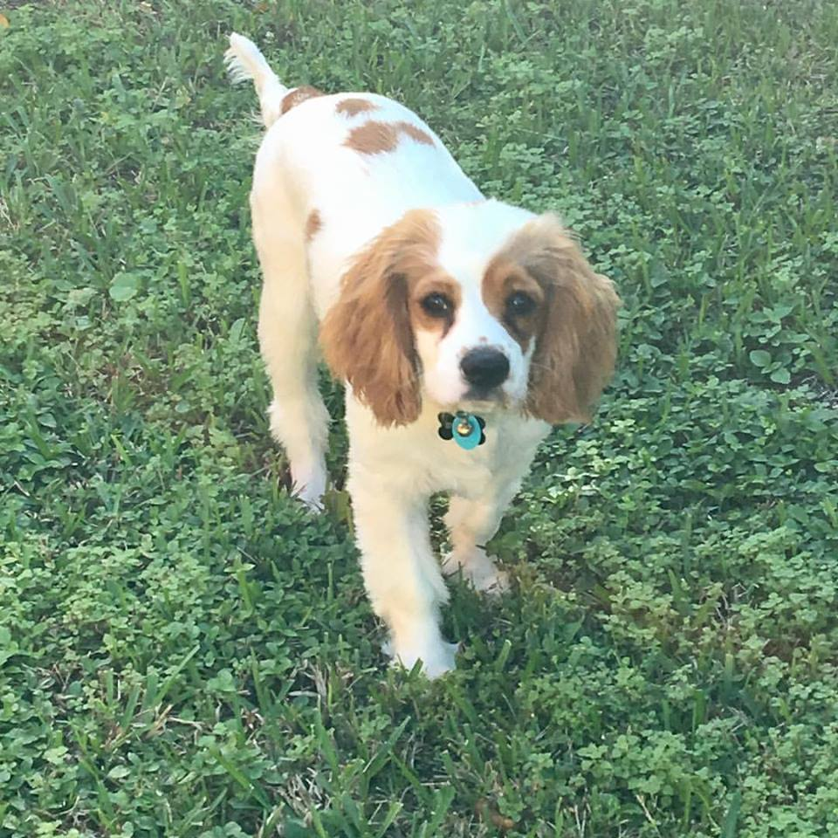
Meet Ms. Frobel
This is my sixth year at Franklin Academy Cooper City. I've taught two years of second grade and three years of third grade.
I graduated from FAU with a degree in Elementary Education.
I have an adorable fur-baby named Bucky. He is a Cocker Spaniel/King Charles Spaniel mix. We live in Davie.
HUGE Marvel fan... Captain America is my favorite :)
I collect Funko Pop figurines.
I am a Disney World passholder.

Slide 3
Curriculum- ELA
FSA:
Statewide Test
Third grade is the first year for possible retention
Combination of FSA test scores, i-Ready assessments, and classroom grades
I-Ready:
Use i-Ready packets to teach. Send home for you to review!
Allows students to become accustomed to rigorous material and vocabulary.
Will ask for parent volunteers to make copies! =)
In Class:
Novel Studies
Wonder & Holes- Favorites!
Spelling Quiz with dictation sentence will be combined with Vocab/Grammar for ONE total grade!
Cold Read tests given when standard has been taught completely to show mastery
*Cold Reads will be difficult at first as students adjust. 3rd grade is rigorous from the start to ensure our students master their standards.*

Slide 4
FSA- Florida Standards Assessment
FSA/Alternative Assessments:
Portfolio Assessments– happens over a period of months by completing projects. Each task has a specific rubric for us to score.
SAT10 is given at the end of the year an alternative to be promoted for those students who scored a Level 1.
Back to PAPER BASED TESTING for both Reading & Math this year!
Target score- We would like to encourage students to consistently score a level 3 or above. (Highest level is 5).
Retention Concerns would be Level 1 and lower Level 2s.
Please encourage reading from the very beginning of the year. This will help us to assist students in reaching their goals!

Slide 5
Accelerated Reader (A.R.)
STAR test every quarter to determine ZPD level (grade level)
Students may take AR quizzes as they finish books to earn points towards their goal
Goal Tracker (Explain wall!)
2 Grades for AR:
1 Grade for Comprehension and 1 Grade for % of Goal met
Will be inputted at halfway mark for interims and updated at end of quarter with final grade

Slide 6
Mathematics
Textbook
GO Math Florida Standards
Textbook pages ripped and sent home after lesson for further review
Practice workbook pages sent home for extra review…sometimes will taken as classwork.
AT HOME:
Multiplication practice (Memorize! Memorize! Memorize!)
Division facts
Adding and subtracting with regrouping
Place value/Rounding
Practice word problems with multi-step answers
*MULTIPLICATION FACTS ARE IMPERATIVE FOR 3RD GRADE SUCCESS! PLEASE START EARLY!*

Slide 7
Science & Social Studies
STEM Scopes
STEM Scopes is new series adopted by Broward County.
More rigorous material and hands-on experiments.
STEM lab is a Special and is in the 7 day rotation.
Practicing Engineering and thinking outside of the box to solve a problem ☺
Social Studies
Just received new resources; Magazines will come home after lessons are completed!
Special Projects:
Living Museum (February)
Fall Rotations (November)

Slide 8
School Website cc.franklin-academy.org
SCHOOL INFO: lunch calendars/payments, find faculty and staff, student/parent handbook, communicating absences
EVENTS: school calendar
STUDENT ACTIVITIES: clubs and athletics
FOR PARENTS: PowerSchool, PTO and Service Hours

Slide 9
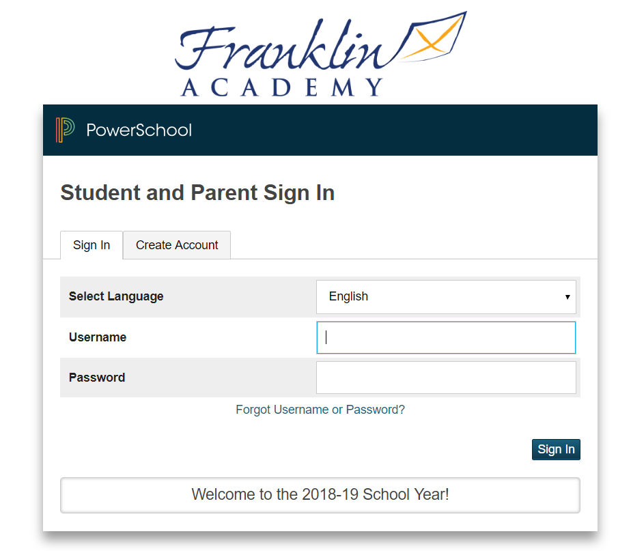
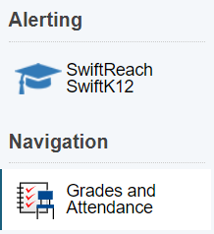
PowerSchool
PS.Franklin-Academy.org/public
-Student Attendance
-Student Grades
-PowerSwiftK12-school communication
Students received their own log in as well

Slide 10
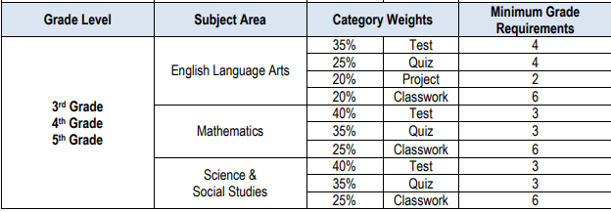
Grade Weights

Slide 11
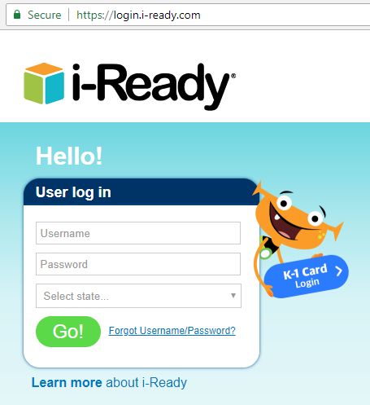
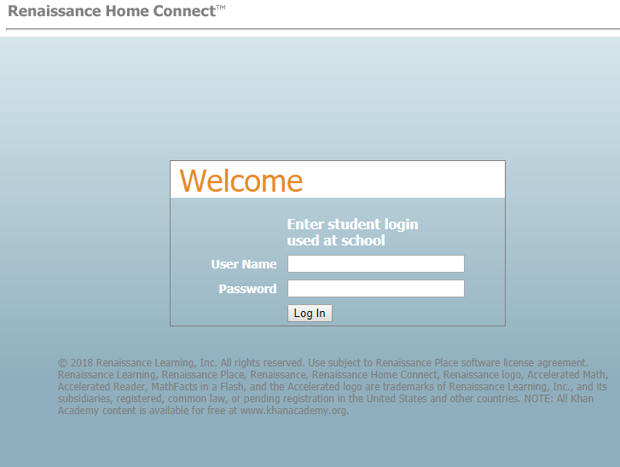
Accelerated Reader (AR) & i-Ready
https://hosted214.renlearn.com/3369044/HomeConnect/Login.aspx
AR Log In = student username and password

Slide 12
General Reminders
School-Wide Expectations = all starts with RESPECT
Supplies = be prepared, no dropping off materials/work at the office
Study Skills = study, i-Ready, MyHRW (math), StemScopes (science)
Assignments = be timely, points deducted daily

Slide 13
Class Website
www.msfrobel.weebly.com
www.faccthirdgrade.weebly.com
Be sure to check our website at the beginning of each week for skills, tests, important events, and study materials.

Slide 14
Class Dojo
I fully implement Class Dojo to track our classroom behavior and daily happenings.
Easy to use App for your phone keeps you connected & involved!
Students will earn points for good behaviors and lose points for undesired behaviors.
Receive immediate notifications of when your student earns points or loses points, and what the exact behavior was.
Messaging section for texting-like messaging between parents and myself
Message blasts for reminders

Slide 15
Classroom Incentives
Class Dojo Rewards:
Lunch Bunch- 90% positive behavior at end of the month
Treasure Box
Whole Class:
Compliment Jar: 25 marbles to earn a treat
Extra Recess

Slide 16
Volunteering/Chaperoning
There will not be many in-classroom opportunities for volunteering.
I will send emails asking for copies or at-home projects.
Copies will be for my class or sometimes for the third grade team
At-home projects are mostly preparing centers/materials that we will use in class (printing, laminating, and cutting)
Third Grade Events:
Emails will be sent out with requests for on-campus volunteering should they arise.
CHAPERONING
Field trip chaperone requests will be put into a bag and I will choose randomly from the bag in front of the students so that it is completely random.
This is to be as fair as possible!
Once you have been chosen as a chaperone, unfortunately you will not be chosen for another field trip to give other families an opportunity!

